Slide 1
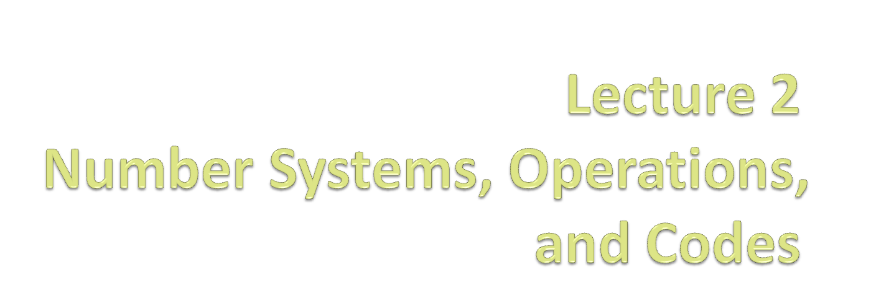

Slide 2
Decimal Numbers
Binary Numbers
Decimal-to-binary Conversion
Binary Arithmetic
1’s and 2’s Complements of Binary Numbers
Signed Numbers
Binary Coded Decimal
Digital Codes

Slide 3
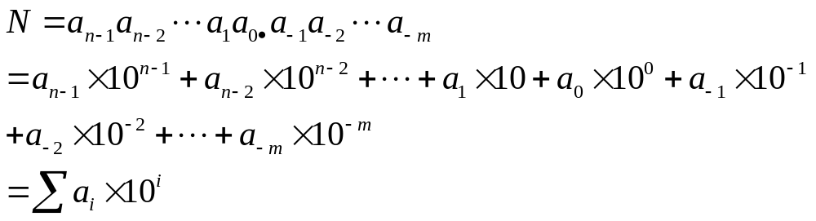
2.1 Decimal Numbers
The position of each digit in a decimal number indicates the magnitude of the quantity represented and can be assigned a weight
5236.71
    = 5×1000+2×100+3×10+6×1+7×0.1+1×0.01
    = 5×10³+2×10²+3×10¹+6×10⁰+7×10⁻¹+1×10⁻²
For an arbitrary decimal number

Slide 4
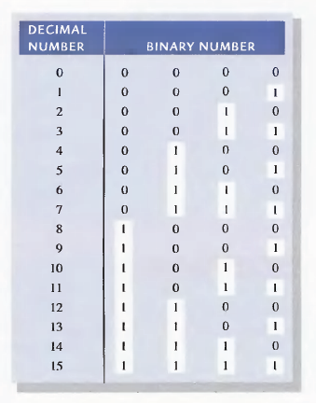
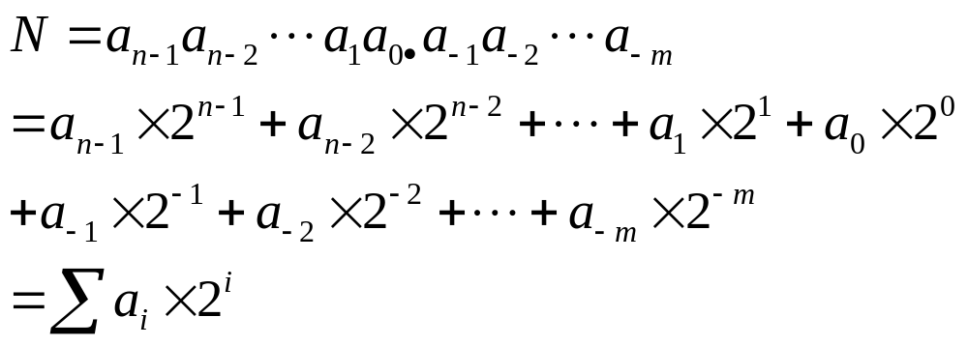
2.2 Binary Numbers
The binary system with its two digits is a base-two system

Slide 5
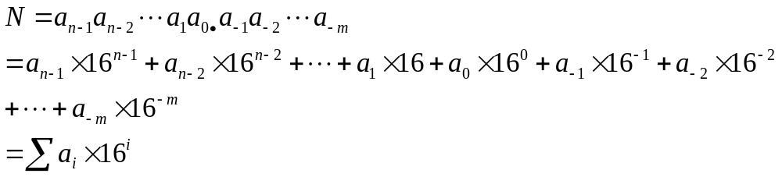
Hexadecimal Numbers
  Widely uses in computer and microprocessor applications
  A(10),B(11),C(12),D(13),E(14),F(15);

Slide 6
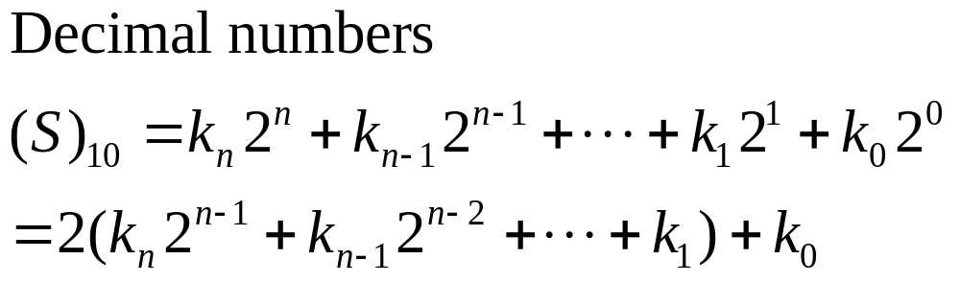
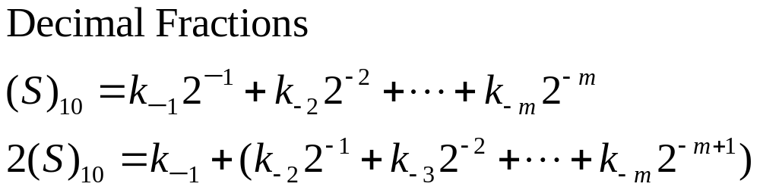
Conversions
Binary-to-decimal conversions
  Adding the weights of all 1s in a binary number to get the decimal value
Decimal-to-binary conversions

Slide 7
Conversion from Binary
Q-1: Convert 101011.11₂ to base 10
101011.11₂
= 1x2⁵ + 0x2⁴ + 1x2³ + 0x2² + 1x2¹ + 1x2⁰ + 1x2⁻¹ + 1x2⁻²
= 32 + 0 + 8 + 0 + 2 + 1 + ½ + ¼
= 43.75₁₀
Q-2: Convert 173.8125₁₀ to base 2.
173.8125₁₀=( ? )₂

Slide 8
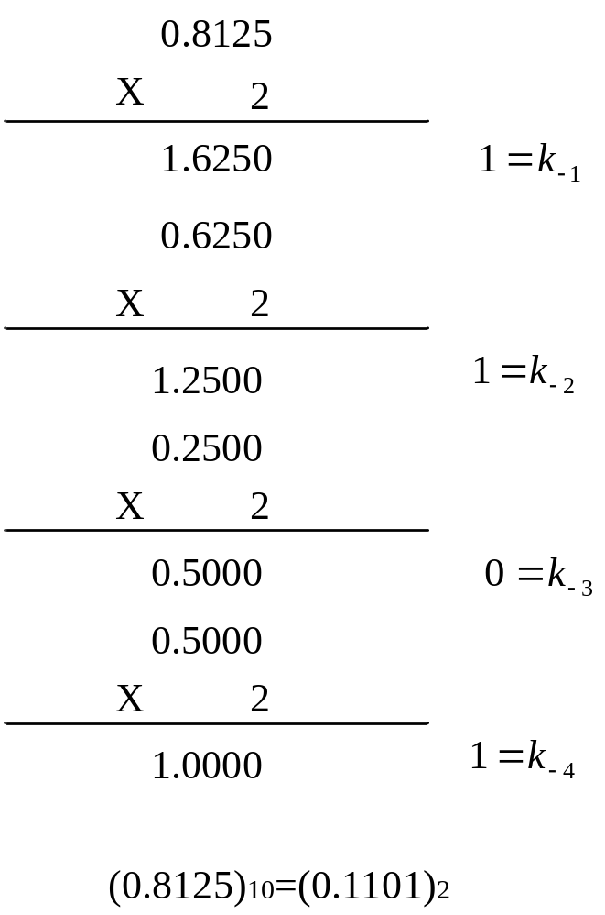
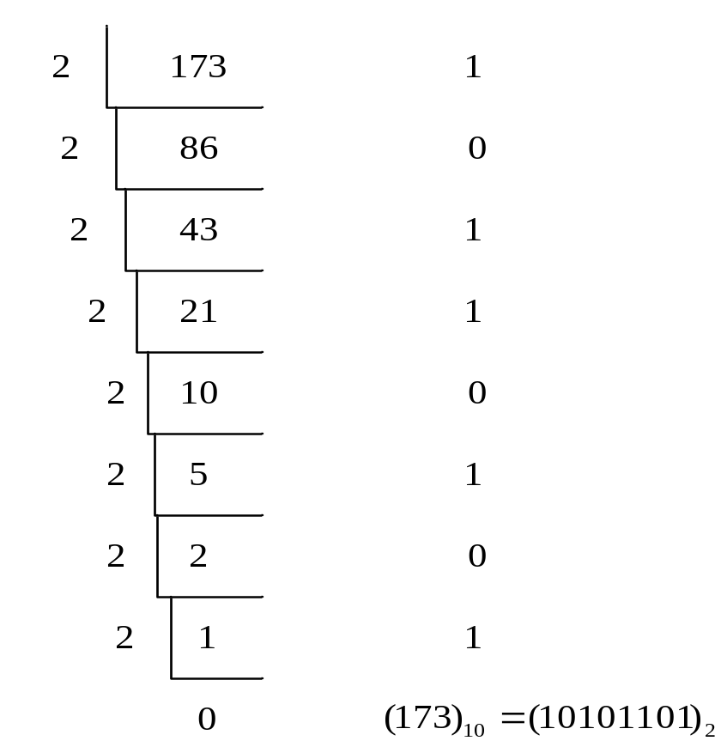
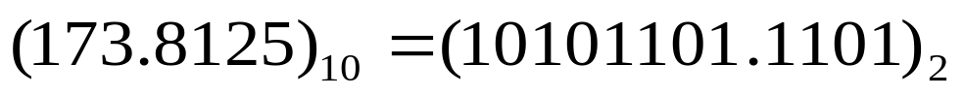
Conversion from decimal to binary

Slide 9
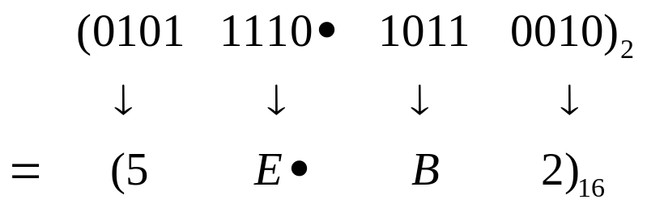
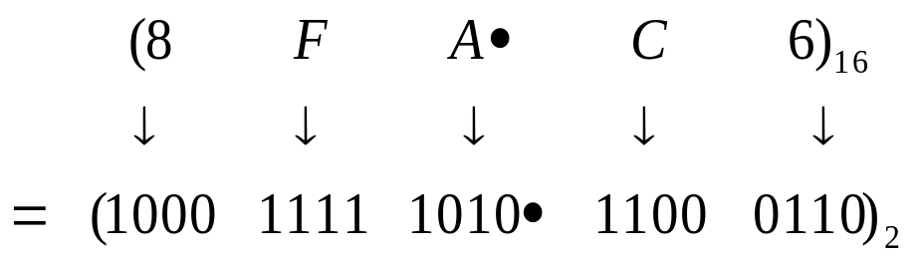
Binary-to-hexadecimal conversion
Hexadecimal-to-binary conversion

Slide 10
2.3 Signed Numbers （符号数）
Sign-magnitude form （原码形式）
1’s complement form（反码形式）
2’s complement form（补码形式）

Slide 11


Sign-magnitude Form
A signed number consists of both sign and magnitude information
The sign indicates whether a number is positive or negative
The magnitude is the value of the number
The sign bit
  A ‘0’(zero) sign bit indicates a positive number and a ‘1’ sign bit indicates a negative number
Magnitude
Magnitude
Sign
Sign

Slide 12
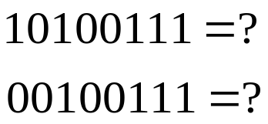
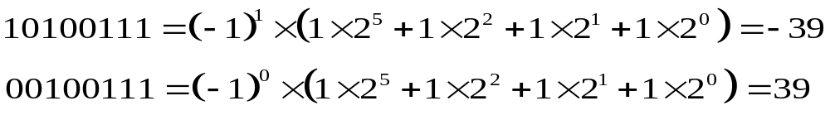
Example
Decimal number | Sign-magnitude form
25 | 0001 1001
-25 | 1001 1001
39 | 0010 0111
-39 | 1010 0111
Example

Slide 13
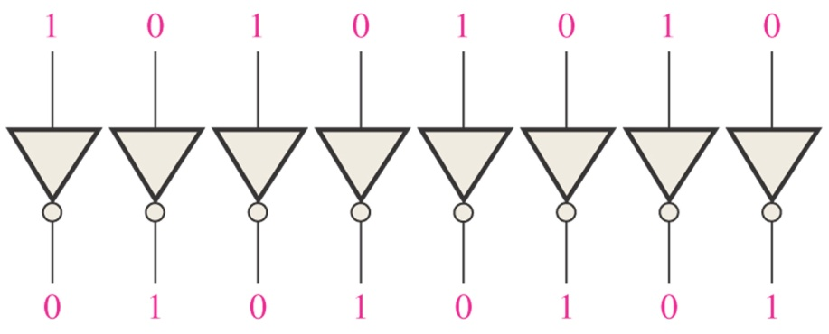
1’s Complement Form of Signed Numbers
Positive numbers: the same as the positive sign-magnitude numbers
Negative numbers: the 1’s complements of the corresponding positive numbers
  Change all 1s to 0s and all 0s to 1s

Slide 14
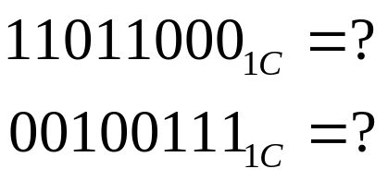
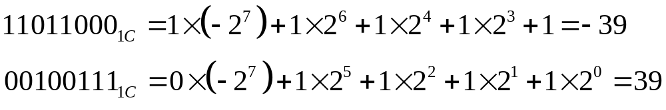
Example
Decimal number | Sing-magnitude form | 1’ s complement form
25 | 0001 1001 | 0001 1001
-25 | 1001 1001 | 1110 0110
39 | 0010 0111 | 0010 0111
-39 | 1010 0111 | 1101 1000
Example
Notes:
See some examples
11111(1C) = -0
10000(1C) = -15
Note there are 32 dots can be expressed for a 5-bit code. 15 dots are placed on the positive axis while 15 dots are placed on the negative axis. The left two dots are on zero.

Slide 15
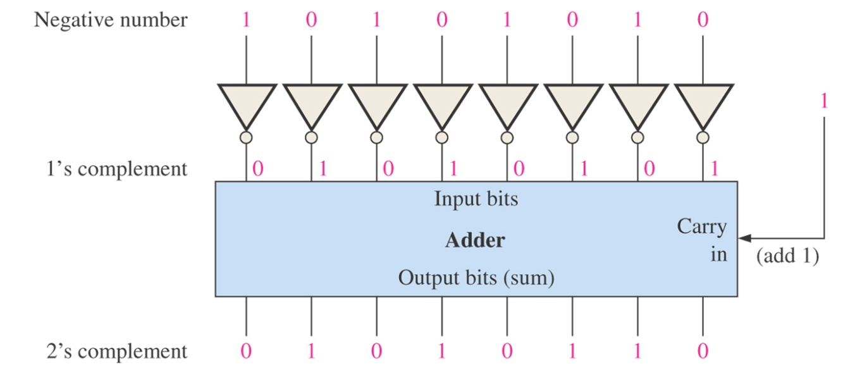
2’s Complement Form of Signed Numbers
Positive numbers: the same as the sign magnitude and 1’s complement forms
Negative numbers: the 2’s complements of the corresponding positive numbers
  Adding 1 to the LSB of the 1’s complement
  2’s complement = ( 1’s complement ) +1

Slide 16
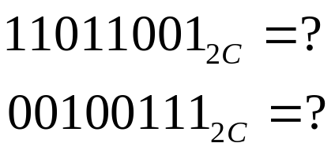
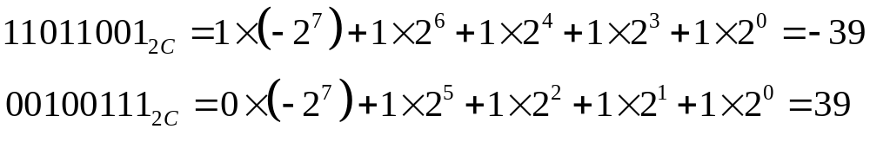
Example
Decimal number | Sing-magnitude form | 1’ s complement form | 2’s complement form
25 | 0001 1001 | 0001 1001 | 0001 1001
-25 | 1001 1001 | 1110 0110 | 1110 0111
39 | 0010 0111 | 0010 0111 | 0010 0111
-39 | 1010 0111 | 1101 1000 | 1101 1001
Example
Notes:
See some examples
11111(2C) = -1
10000(1C) = -16
Note there are 32 dots can be expressed for a 5-bit code. 15 dots are placed on the positive axis while 16 dots are placed on the negative axis. The left one dot is on zero.

Slide 17


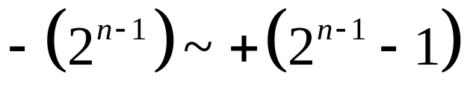
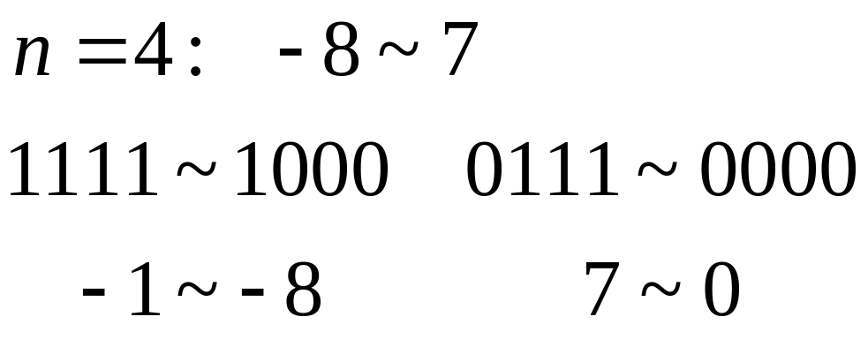
For 2’s complement signed numbers, the range of values for n-bit numbers is
Example

Slide 18
Unsigned integer numbers (magnitude)
0 | 1 | 2 | 3 | 4 | 5 | 6 | 7 | 8 | 9 | 10 | 11 | 12 | 13 | 14 | 15
0000 | 0001 | 0010 | 0011 | 0100 | 0101 | 0110 | 0111 | 1000 | 1001 | 1010 | 1011 | 1100 | 1101 | 1110 | 1111
Signed integer numbers (sign-magnitude form)
-7 | -6 | -5 | -4 | -3 | -2 | -1 | -0 | 0 | 1 | 2 | 3 | 4 | 5 | 6 | 7
1111 | 1110 | 1101 | 1100 | 1011 | 1010 | 1001 | 1000 | 0000 | 0001 | 0010 | 0011 | 0100 | 0101 | 0110 | 0111
Signed integer numbers (1’s complement form)
-7 | -6 | -5 | -4 | -3 | -2 | -1 | -0 | 0 | 1 | 2 | 3 | 4 | 5 | 6 | 7
1000 | 1001 | 1010 | 1011 | 1100 | 1101 | 1110 | 1111 | 0000 | 0001 | 0010 | 0011 | 0100 | 0101 | 0110 | 0111
Signed integer numbers (2’s complement form)
-8 | -7 | -6 | -5 | -4 | -3 | -2 | -1 | 0 | 1 | 2 | 3 | 4 | 5 | 6 | 7
1000 | 1001 | 1010 | 1011 | 1100 | 1101 | 1110 | 1111 | 0000 | 0001 | 0010 | 0011 | 0100 | 0101 | 0110 | 0111

Slide 19
Floating-point Numbers
A floating-point number consists of two parts plus a sign.
The mantissa（尾数部分）: the part of a floating-point number that represents the magnitude of the number.
The exponent（指数部分）: the part of a floating-point number that represents the number of places that the decimal point is to be moved.
Single-precision: 32 bits
Double-precision: 64 bits
Extended-precision: 80 bits

Slide 20
Example
1 0110 1001 0001 = 1.0110 1001 0001 x 2¹²
(Assuming this is a positive number)
Exponent 12+127=139 --------->1000 1011
Mantissa 0110 1001 0001
(The 1 left of the binary point is not included)
S | Exponent | Mantissa (Fraction)
0 | 1000 1011 | 01101001000100000000000
1 bit
8 bit
23 bit

Slide 21
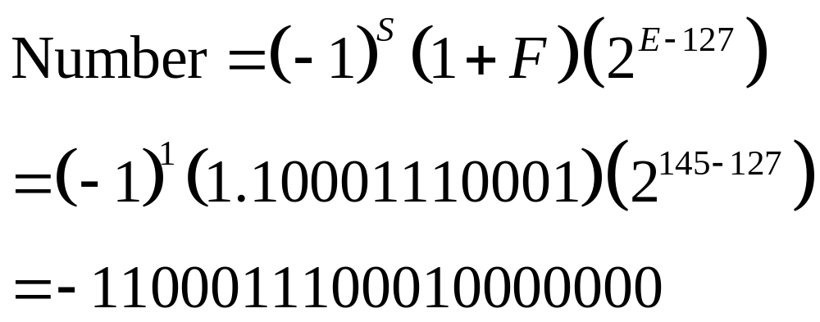
Example
Determine the binary value of the following floating-point binary number.
S | Exponent | Mantissa (Fraction)
1 | 10010001 | 10001110001000000000000

Slide 22
2.4 Addition with Binary Numbers

Slide 23
For Unsigned Numbers

Slide 24
Binary Addition
0 + 0 = 0
0 + 1 = 1
1 + 0 = 1
1 + 1 = 0 and carry 1 to the next column
Examples:
0101 (5₁₀)
+ 0010 (2₁₀)
0111 (7₁₀)
1 1 1
0101 (5₁₀)
+ 0011 (3₁₀)
1000 (8₁₀)
Carries

Slide 25
Binary Addition
Add 6-bit numbers 45₁₀ and 44₁₀ in binary
1 1 1
101101 (45₁₀)
+ 101100 (44₁₀)
1011001 (89₁₀)
Carries
If the operands are unsigned, you can use the final carry-out
as the MSB of the result.
Adding 2 k-bit numbers ⬄ k+1 bit result

Slide 26
For Signed Numbers
---- Use the form of 2’s Complement

Slide 27
Two’s Complement Addition
Both numbers positive
Both numbers negative
0 0 1
0101 (+5₁₀)
+ 0001 (+1₁₀)
0110 (+6₁₀)
1 1 1
1011 (-5₁₀)
+ 1111 (-1₁₀)
1010 (-6₁₀)
Positive number with magnitude larger than negative number
Negative number with magnitude larger than positive number
1 1 0
0110 (+6₁₀)
+ 1111 (-1₁₀)
0101 (+5₁₀)
0 0 0
1010 (-6₁₀)
+ 0001 (+1₁₀)
1011 (-5₁₀)
Operation is same as for unsigned.
Same rules, same procedure.

Slide 28
Overflow Condition
The number of bits required to represent the sum exceeds the number of bits in the two added numbers
Indicated by an incorrect sign bit
Condition:
  Only when both numbers are positive or both numbers are negative
  The sign bit of the result is different than the sign bit of the numbers that are added
01111101 (+125₁₀)
+ 00111010 (+58₁₀)
10110111 (+183₁₀)
Incorrect sign and magnitude

Slide 29
Sign-Extension in 2’s Complement
To make a k-bit number wider
  replicate sign bit
110_{2C} = -1 x 2² + 1 x 2¹ = -2₁₀
1110_{2C} = -1 x 2³ + 1 x 2² + 1 x 2¹ = -2₁₀
11110_{2C} = -1 x 2⁴ + 1 x 2³ + 1 x 2² + 1 x 2¹ = -2₁₀

Slide 30
More Sign-Extension
010_{2C} = 1 x 2¹ = 2₁₀
0010_{2C} = 1 x 2¹ = 2₁₀
00010_{2C} = 1 x 2¹ = 2₁₀
Works for both positive and negative numbers!

Slide 31
2.5 Binary Coded Decimal (BCD)
A way to express each of the decimal digits with a binary code
The 8421 BCD Code
    0 --------> 0000
    1 --------> 0001
    …
    9 --------> 1001

Slide 32
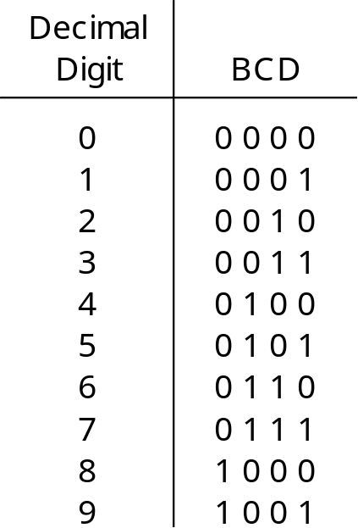
Convert 2496₁₀ to BCD Code
2 4 9 6
0 0 1 0 0 1 0 0 1 0 0 1 0 1 1 0
Note this is very different from converting
to binary which yields:
1 0 0 1 1 1 0 0 0 0 0 0₂

Slide 33
ASCII Code
ASCII ➔ American Standard Code for Information Interchange
ASCII is a 7-bit code used to represent letters, symbols, and terminal codes
There are also Extended ASCII codes, represented by 8-bit numbers
Terminal codes include such things as:
Tab (TAB)
Line feed (LF)
Carriage return (CR)
Backspace (BS)
Escape (ESC)
And many more!

Slide 34
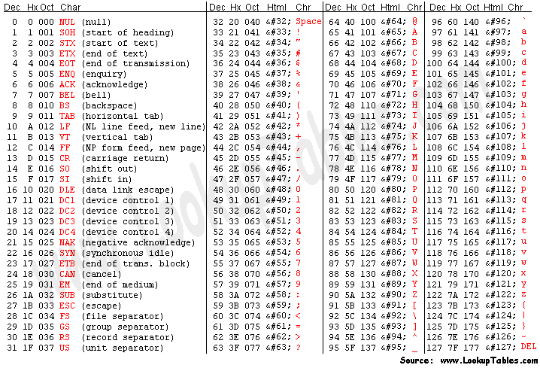
ASCII Code

Slide 35
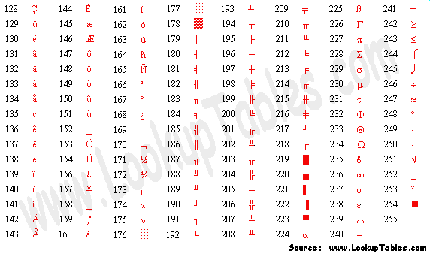
Extended ASCII Code

Slide 36
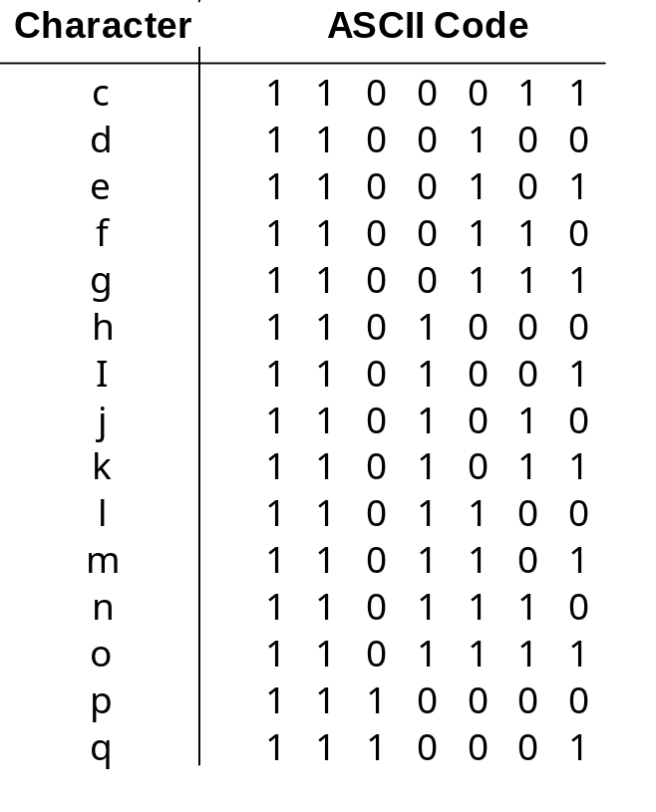
ASCII Code (partial)
Convert “help” to ASCII
h e l p
1101000 1100101 1101100 1111000
0x68 0x65 0x6C 0x70

Slide 37
2.6 Digital Codes
The Gray Code
  Unweighted and not an arithmetic code
  No specific weights assigned to the bit positions
  Important feature: exhibits only a single bit change from one code word to the next in sequence

Slide 38
Table 2-6 Four-bit Gray code
DECIMAL | BINARY | GRAY CODE | DECIMAL | BINARY | GRAY CODE
0 | 0000 | 0000 | 8 | 1000 | 1100
1 | 0001 | 0001 | 9 | 1001 | 1101
2 | 0010 | 0011 | 10 | 1010 | 1111
3 | 0011 | 0010 | 11 | 1011 | 1110
4 | 0100 | 0110 | 12 | 1100 | 1010
5 | 0101 | 0111 | 13 | 1101 | 1011
6 | 0110 | 0101 | 14 | 1110 | 1001
7 | 0111 | 0100 | 15 | 1111 | 1000

Slide 39
Binary-to-Gary Code Conversion
  The MSB in the Gray code is the same as the corresponding MSB in the binary number
  Going from left to right, add each adjacent pair of binary code bits to get the next Gray code bit
  Discard carries
  Example
  10110 (binary) --------> 11101 (Gray code)

Slide 40
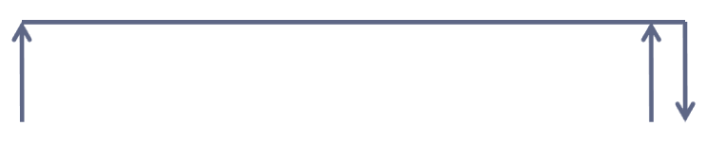
Gray-to-Binary Conversion
  The MSB in the binary code is the same as the corresponding bit in the Gray code
  Add each binary code bit generated to the Gray code bit in the next adjacent position
  Discard carries
  Example
  11011 (Gray code) --------> 10010 (binary)

Slide 41
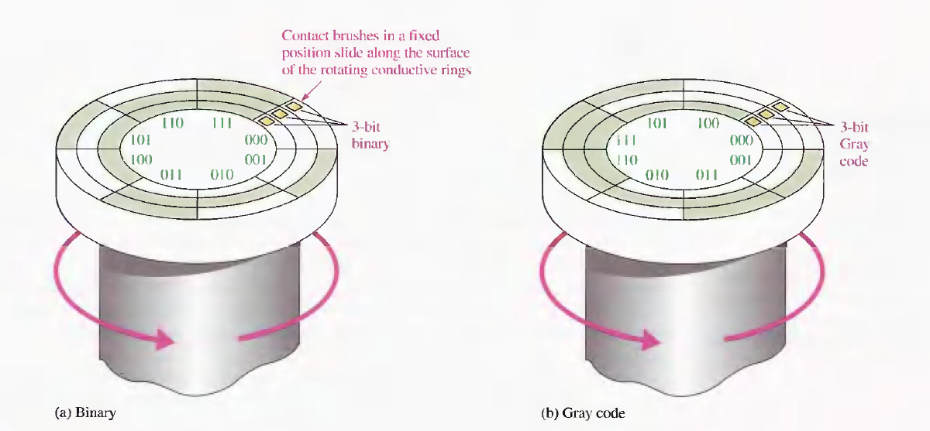
An application of Gray Code

Slide 42
Summary
Number systems
  Binary, decimal, hexadecimal
Singed number
Arithmetic operation
Codes

Slide 43
HW
Page 59~62
  11
  15
  22
  23
  28
  31
  51
  56
  Q: What are the advantages if we implement the addition of two signed-numbers through their forms of 2’s complement?

